Slide 1
Simple Application of Face Swapping
XIE Suiwei 2030026168
Ma Yishu 2030026107
Notes:
http://shop182684730.Taobao.com 各种风格、行业应用高端PPT模板，代做PPT。
淘宝搜索店铺关于一切设计About Design可查看详情。

Slide 2
1
2
3
4
Facial Landmarks Extraction
市场数据分析
Video Face Swapping
下一步工作计划
Notes:
http://shop182684730.Taobao.com 各种风格、行业应用高端PPT模板，代做PPT。
淘宝搜索店铺关于一切设计About Design可查看详情。

Slide 3
Facial Landmarks Extraction

Slide 4
Facial Landmarks Extraction
Process Flow
Pesudo-Code
Initialize the facial landmark detector: dlib.get_frontal_face_detector()
Convert the image to grayscale
Perform face detection
returns a list of face objects
Iterate over detected faces
Draw a rectangle around the face
Predict facial landmarks: dlib
Iterate over the predicted landmarks:
Retrieve the coordinates of the landmark.
Draw a circle at the landmark position on the original image
detector = initialize_facial_landmark_detector()
gray = convert_to_grayscale(image)
faces = detect_faces(gray)
for face in faces:
draw_rectangle(image, face)
landmarks = predict_facial_landmarks(gray, face)
for landmark in landmarks:
x, y = get_landmark_coordinates(landmark)
draw_circle(image, x, y)
display_image(image)

Slide 5


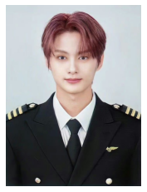
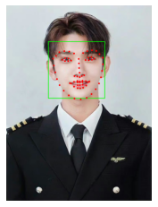
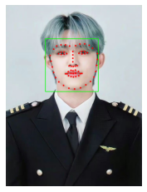

Facial Landmarks Extraction
Original
Result

Slide 6
Align Faces with a Procrustes Analysis
calculate_affine_matrix(landmarks1, landmarks2):
# Calculate the mean of the set of points
c1 = calculate_mean(landmarks1)
c2 = calculate_mean(landmarks2)
# Centralized set of points
landmarks = landmarks1 - c1
landmarks2 = landmarks2 - c2
# Calculate the standard deviation of the set of points
s1 = calculate_std(landmarks1)
s2 = calculate_std(landmarks2)
# Normalized point set
landmarks = landmarks1 / s1
landmarks2 = landmarks2 / s2
# Calculate the eigenvectors and eigenvalues between point sets
U, S, Vt = svd(transpose(landmarks1) * landmarks2)
# Computed rotation matrix
R = transpose(U * Vt)
# Construct an affine matrix
affine_matrix = stack([stack([(s2 / s1) * R, transpose(c2) - (s2 / s1) * R * transpose(c1)]),
[0, 0, 1]])
return affine_matrix
Process Flow
Pesudo-Code
The affine transformation matrix is a 3x3 matrix
first two rows are the rotation matrix multiplied by the scaling factor
last row is the translation vector used to transform a point from one coordinate system to another
Translation
calculating the average value, landmarks are normalized.
Global scaling
calculates the variance of the landmarks
Rotation matrix
Calculate the rotation matrix (R) using Singular Value Decomposition (SVD)
Notes:
The two faces have their own landmarks. Now we need to align face B with a face so that the result can look more real. But because A and B face size, rotation and so on are not quite the same, how to transform? The answer is to use Procrustes analysis to find a transformation matrix from B to A

Slide 7
市场数据分析

Slide 8
市场数据分析
100%
标题文字添加
The user can demonstrate on a projector or computer, or print the presentation and make it into a film to be used
75%
60%
45%
标题文字添加
The user can demonstrate on a projector or computer, or print the presentation and make it into a film to be used
25%
15%
20%
2013
2014
2015
2016
2017
2018
2019

Slide 9



市场数据分析
标题文字添加
标题文字添加
标题文字添加
The user can demonstrate on a projector or computer, or print the presentation and make it into a film to be used
The user can demonstrate on a projector or computer, or print the presentation and make it into a film to be used
The user can demonstrate on a projector or computer, or print the presentation and make it into a film to be used

Slide 10
市场数据分析
标题文字添加
标题文字添加
The user can demonstrate on a projector or computer, or print the presentation and make it into a film to be used
The user can demonstrate on a projector or computer, or print the presentation and make it into a film to be used
标题文字添加
标题文字添加
The user can demonstrate on a projector or computer, or print the presentation and make it into a film to be used
The user can demonstrate on a projector or computer, or print the presentation and make it into a film to be used

Slide 11
Video Face Swapping

Slide 12
Pesudo-Code
Video Face Swapping
capture = cv2.VideoCapture("junface.mp4")
fourcc = cv2.VideoWriter_fourcc('m', 'p', '4', 'v')
out = cv2.VideoWriter('jun_face_change_video.mp4', fourcc, 29.44, (960,720))
detector = initialize_facial_landmark_detector()
predictor=dlib.shape_predictor("shape_predictor_68_face_landmarks.dat")
count = 0
while True:
if count==58: # set the frame amount we want to save
break
ret,img=capture.read()
if not ret:
break
do image face-swapping operations
if cv2.waitKey(1) & 0xff == ord('q'):
break
cv2.imwrite('./jun_video/output'+str(count)+'.jpg', output_im)
count+=1
end while
for i in range(count):
out.write(cv2.imread("./jun_video/output"+str(i)+".jpg"))
end for
capture.release()
out.release()
cv2.destroyAllWindows()
Process Flow
Set parameters to read and write the video.
Initialize the facial landmark detector: dlib.get_frontal_face_detector()
Read each frame of the video
Perform face swapping operation the same as operation 2 until we traverse all frames, save each frame as an image.
Traverse each image and save it as video, which has the same fps and size as the original video.

Slide 13
Video Face Swapping
Problem:
Eyebrow part is untrue
Expression do not change

Slide 14
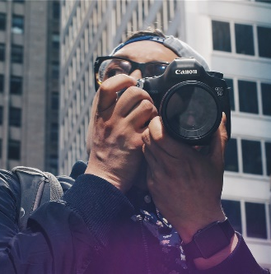



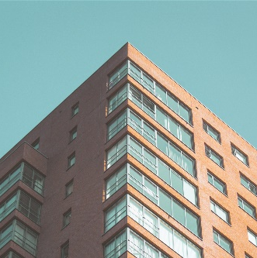
面临问题及解决措施
标题
文字添加
标题
文字添加
标题
文字添加
标题
文字添加
标题
文字添加

Slide 15
下一步工作计划

Slide 16
下一步工作计划
The user can demonstrate on a projector or computer,
文字添加
The user can demonstrate on a projector or computer, or print the presentation and make it into a film to be used
文字添加
The user can demonstrate on a projector

Slide 17
下一步工作计划
Morbi dignissim nisl in diam sagittis, id dapibus nulla pretium. Sed vitae quam metus. Morbi dignissim nisl in diam sagittis, id dapibus nulla pretium. Sed vitae quam metus.
2015
2016
2017
2018
2019
2020
TEXT
TEXT
TEXT
TEXT
TEXT
TEXT

Slide 18
THANKS FOR YOUR COMING
Morbi dignissim nisl in diam sagittis, id dapibus nulla pretium. Sed vitae quam metus. Etiam fermentum turpis vel lectus dignissim consectetur.

